Slide 1
M-Cars
Drive your personality

Slide 2
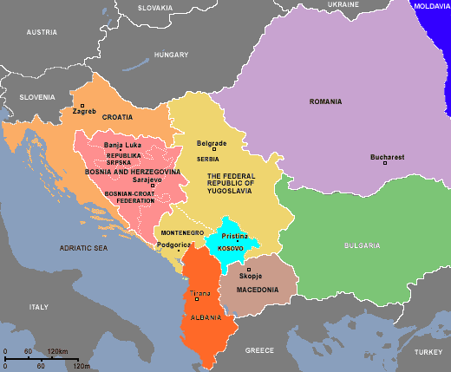
About us
We’re a small, yet powerfull company with thousand of custimers all over Croatia and other Balkan countries.

Slide 3
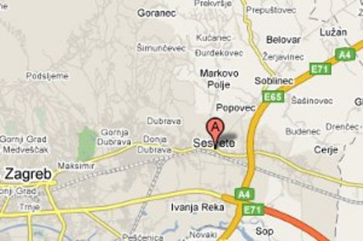
--continued
We are located in Sesvete, Zagreb.
Our adress is: Eduard Švager Kotelić Street 23a

Slide 4
What do we sell?
As you could assume, we sell automobiles, a.k.a.- cars.
We sell only the most popular and the best cars, such as:

Slide 5
Toyota
Renault
Citroen
Chevrolet
Škoda
Opel
Mercedes
Ford

Slide 6
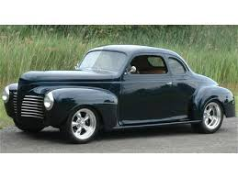
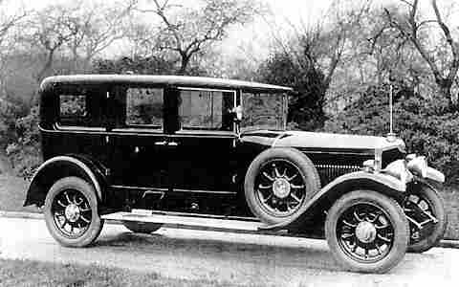
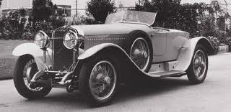
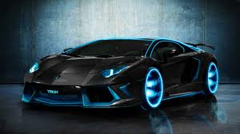
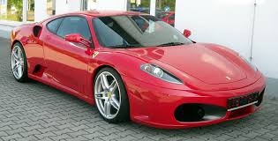
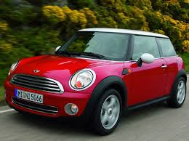
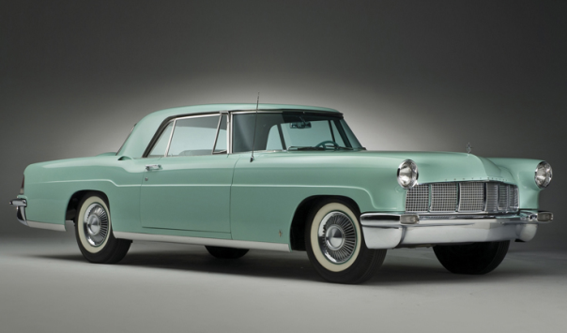
Our Exclusive offer
In the EO we offer you a limited edition of Lamborgini, Ferrari, Cooper, and vintage 1920s, 1930s, 1940s and 1950s cars.

Slide 7
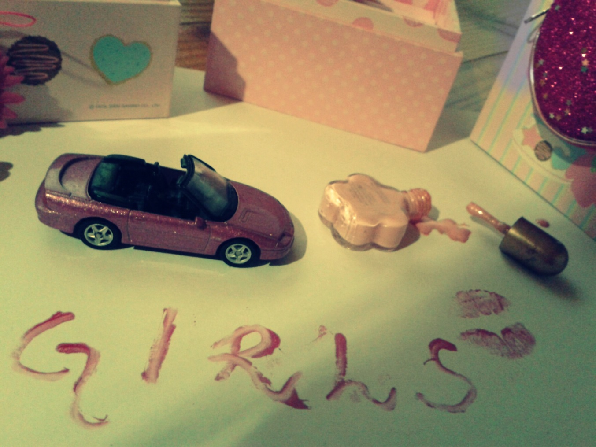
What’s your personality?
If you’re a girly girl, our offer is:

Slide 8
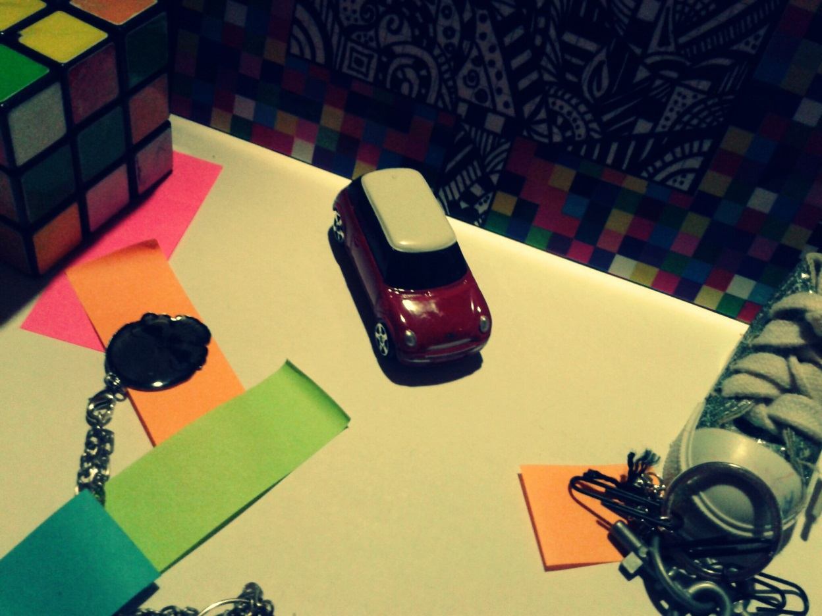
What’s your personality?
If you’re a urban time lover:

Slide 9
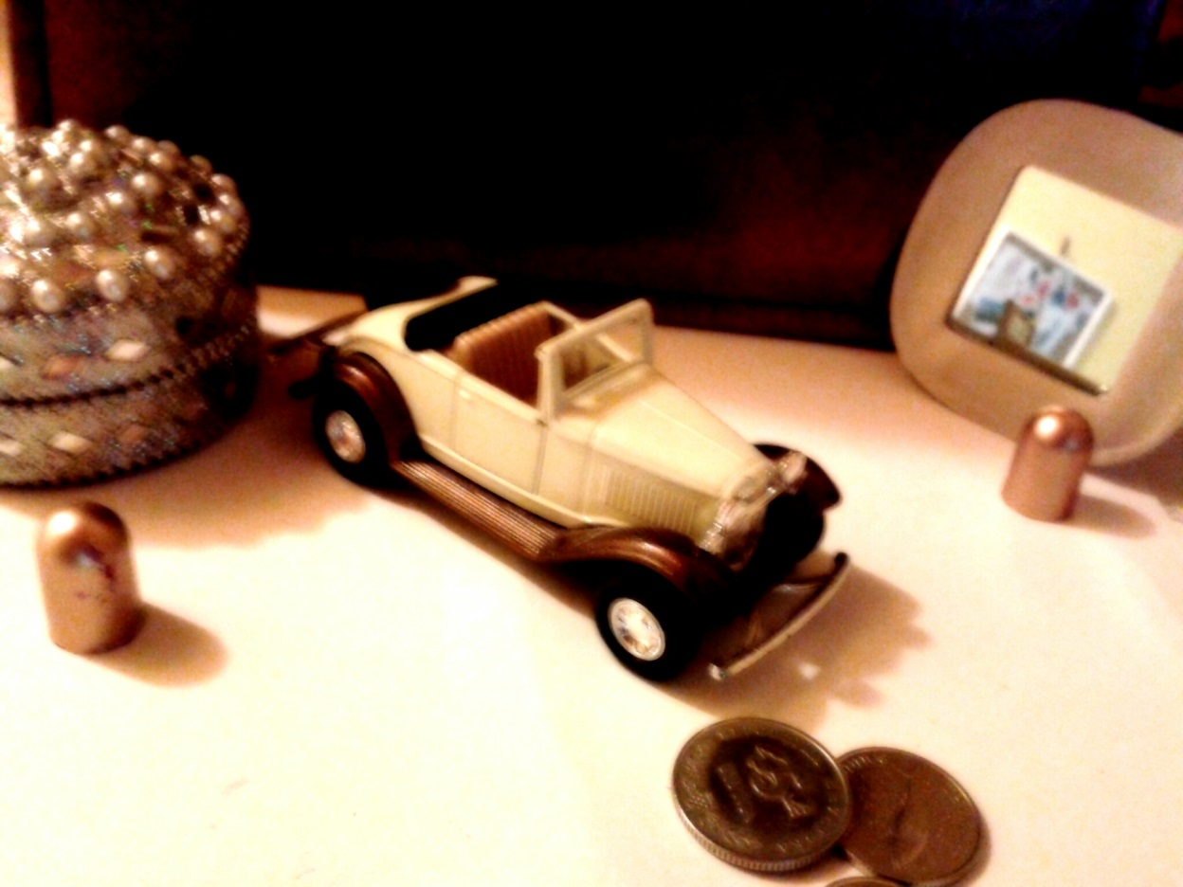
What’s your personality?
If you are a vintage lover:

Slide 10
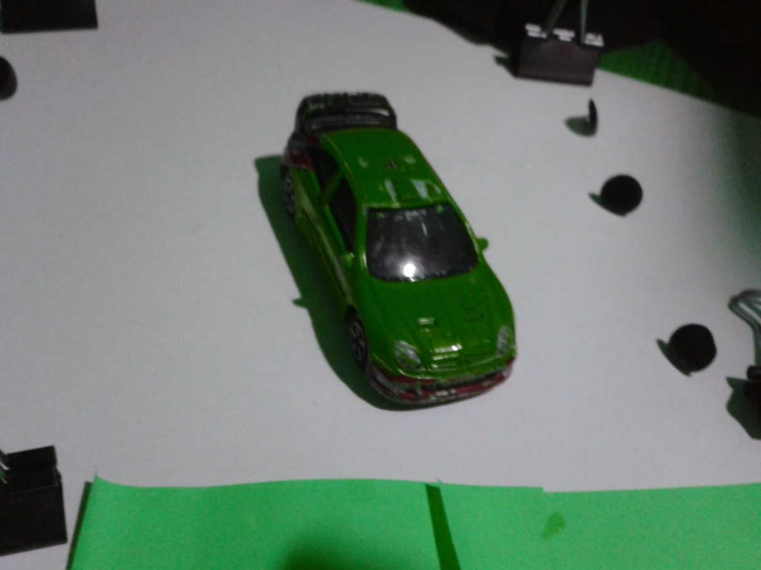
What’s your personality?
If you are a sports fan searching for a „sharp” car:

Slide 11
About the Personality cars
Personaltity cars are cars selected for the four groups:
Girly
Vintage
Urban
Sporty

Slide 12
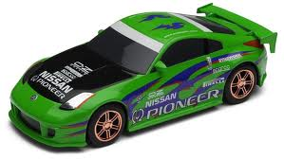
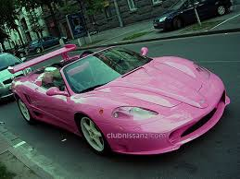
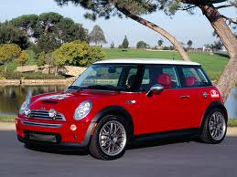
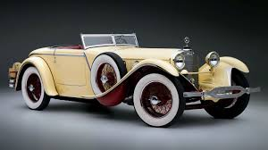
A question 4U
What’s your type of a car in the Personality Cars?
Girly, Sporty, Urban or Vintage?

Slide 13
Prices
Our prices are low, going from 65000 kn, to 200000 kn
The EO prices are the highest, going from 100000 kn to 200000 kn.

Slide 14
The end.
For more details, visit: www.m/cars.com
Company’s executive director,
Magdalena Arapović

