Slide 1
Frank

Slide 2
Frank has many products.
Some of them are…

Slide 3
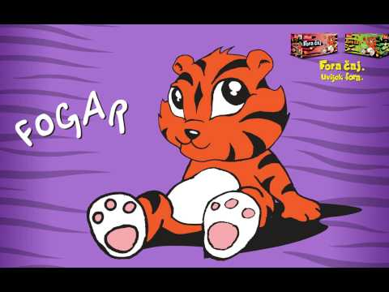
Cool tea
Cool tea…
the best choice for the youngest

Slide 4
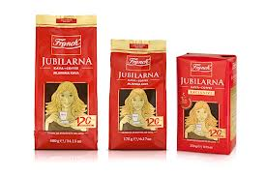
coffe
Coffe…
the most famous our product for adults

Slide 5
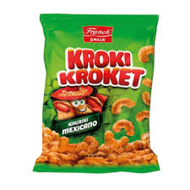
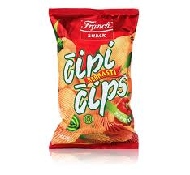
Frank snacks
Frank Snacks…
the best choice between the meals, no matter how old you are

Slide 6
Buy some Frank’s product and enjoy yourself!

Slide 7
END
Mihael fajić 7.a

